Slide 1

How to Prepare Your Property for Loss Control Inspections

Slide 2
Agenda
Who will be conducting the surveys
The locations for 2026
Data shows us the most frequent recommendations
Types of recommendations and solutions
Documentation to prepare

Slide 3
Who is completing the surveys for 2026
Who is HSB:
The Hartford Steam Boiler Inspection and Insurance Company is a global specialty insurer and reinsurer headquartered in Hartford, Connecticut.
Stephen Greeson, PE
Telephone: +1 (210) 833-8671
stephen_greeson@hsb.com
Manager Principal Consulting Engineer
The Hartford Steam Boiler
Inspection and Insurance Company
Professional Loss Control Division
One State Street
P.O. Box 5024
Hartford, CT 06102-5024
Telephone: +1 (210) 833-8671

Slide 4
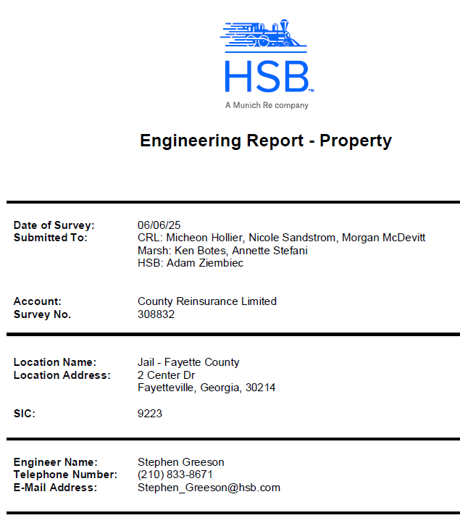

Slide 5
Location Name | Street | City | State | Postal Code | County
Benton County Sheriffs Office - Jail | 1300 SW 14th St | Bentonville | AR | 72712 | Benton
Pulaski Co Detention Center | 3201 West Roosevelt | Little Rock | AR | 72201 | Pulaski
Pulaski Co Courthouse | 401 W Markham | Little Rock | AR | 72201 | Pulaski
Boone County Jail | 3020 Conrad Lane | Burlington | KY | 41005 | Boone
Franklin County Judicial Center | 222 St Clair Street | Frankfort | KY | 40601 | Franklin
Hardin County Detention Center | 100 Lawson Boulevard | Elizabethtown | KY | 42701 | Hardin
Sarpy County Correctional Center Jail | 1206 Golden Gate Dr | Papillion | NE | 68046 | Sarpy
Lake County Sheriffs Office & Jail | 104 E Erie St | Painesville | OH | 44077 | Lake
Licking County Justice Center Correctional Facility | 155 E Main St | Newark | OH | 43055 | Licking
Ross County Law Enforcement Center | 28 N Paint St | Chillicothe | OH | 45601 | Ross
Ross County Courthouse | 2 N Paint St | Chillicothe | OH | 45601 | Ross
Campbell Co Justice Complex | 610 Main Street | Jacksboro | TN | 37757 | Campbell
Cumberland County Sheriff's Office & Jail | 90 Justice Center Drive | Crossville | TN | 38555 | Cumberland
Montgomery County Jail | 116 Commerce Street | Clarksville | TN | 37040 | Montgomery
Sevier County Solid Waste Compost Plant | 1855 Ridge Road | Pigeon Forge | TN | 37863 | Sevier
Legacy Event Center - Western Sports Park | 151 S 1100 W | Farmington | UT | 84025 | Davis
Sanpete County Courthouse | 160 N Main St | Manti | UT | 84642 | Sanpete
Public Safety Building | 631 E 300 S | Vernal | UT | 84078 | Uintah
Dixie Center Rosenbruch Museum | 1835 Convention Center Dr | St George | UT | 84790 | Washington
Weber County Sheriffs Complex | 721 W 12th St | Ogden | UT | 84404 | Weber

Slide 7
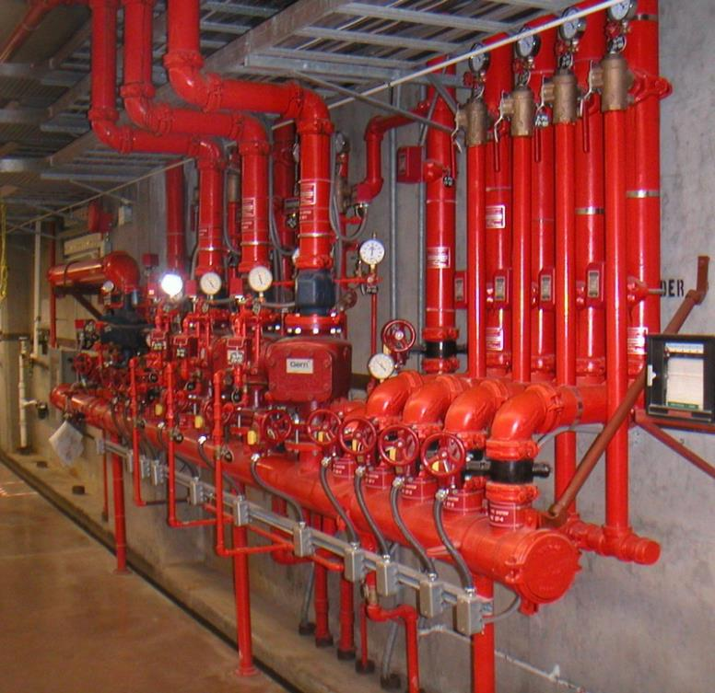
Fire Protection Inspection, Testing, and Maintenance
The common recommendation - Increase the frequency of in-house inspection of the automatic sprinkler system to verify that all components and systems function as intended. Implement testing of the fire protection system booster fire pump for a frequency of monthly per NFPA 25.
Conduct monthly visual inspections of the portable fire extinguishers
Solution: Perform monthly inspections of system risers to verify that normally open valves are in the correct position and that the pressure gage readings are at their typical amount.
Important that the fire extinguishers are available, unobstructed and are fully functional in the event of a fire.
Can be completed by:
County Management
Vendors
Maintenance Staff
$$

Slide 8
Inspection, Testing and Maintenance of Water-Based Fire Protection Equipment per NFPA 25 (2026) based on Frequency
Category | Activity | Item | a. Weekly | b. Monthly | c. Quarterly | e. Annually
Fire Protection Valves | Inspection | Control Valve-roadway box valve | ●
 |  | Control Valves-sealed | ●
 |  | Valve supervisory alarm devices |  |  | ●
 |  | Control Valves-locked |  | ●
 |  | Control Valves-electrically supervised |  |  | ●
 | Maintenance | Control Valves |  |  |  | ●
 | Test | Control Valves-position testing & operation |  |  |  | ●

Slide 9
Inspection, Testing and Maintenance of Water-Based Fire Protection Equipment per NFPA 25 (2026) based on Frequency
Frequency | Activity | Category | Sub Category | Item
a. Weekly | Inspection | Fire Pumps |  | Fire Pump house & system
 |  | Sprinkler system | Dry Pipe System | Dry pipe valve enclosure - during freezing weather (with low temp alarm)
 |  | Standpipe and Hose Systems | Automatic dry standpipe standpipe systems | Gauges
 |  | Valves | Backflow Prevention Assemblies | Reduced pressure assemblies/reduced-pressure detector assemblies
 |  |  | Control Valves | Control Valve-roadway box valve
 |  |  |  | Control Valves-sealed
 |  |  | Preaction/Deluge Type | Preaction/Deluge Valves-Enclosure (temp supervised)
 |  |  | Pressure Reducing and Relief Valves | Fire Pump pressure-relief valves
 |  |  |  | Fire Pump casing relief valve (follows churn test for electric/diesel)
 |  |  |  | Master Pressure-Regulating Devices
 |  | Water Mist Systems | Plant air | Plant air-air pressure (unsupervised)
 |  | Water Spray Fixed Systems |  | Deluge Valve House-heat
 |  | Water Storage Tank | Heating System | Water storage tank-heating system (unsupervised low water temp)
 |  |  | Supervision | Water storage tank-low water temperature unsupervised
 | Test | Fire Pumps |  | Fire Pumps –diesel engine no flow test
 |  |  |  | Fire Pumps-no flow test (electric servicing high rise or limited-service controllers, uses vertical turbine pumps, or ground level tank supply)

Slide 10
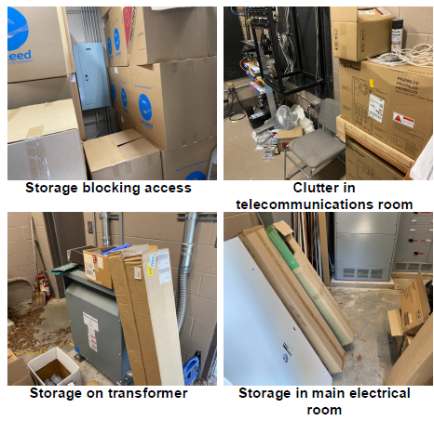
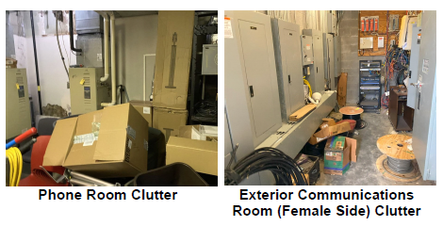
Housekeeping
The common recommendation - Combustible materials that unnecessarily contribute to the fuel load of this room as well as produce a continuity of combustibles: The Main IT Server Room / Roof Access Stairwell / File Storage / HVAC Mechanical and main electrical room.
Solution: Remove and affixing a sign to the doors stating that combustible storage is prohibited in the rooms.
Can be completed by:
County Management
Vendors
Maintenance Staff
$

Slide 11
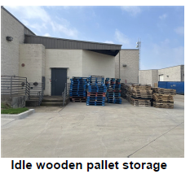
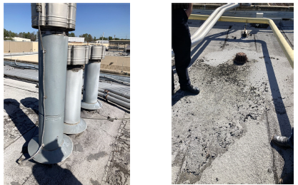
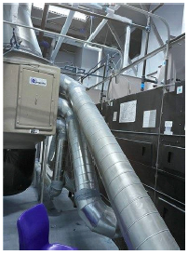
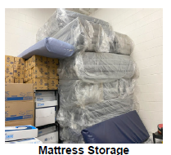
Housekeeping - Additional
The common recommendation - Cloths Dryer Exhaust Vents Inspection and Cleaning / Procedure and control that addresses the foamed mattresses in storage.
Solution: Remove and clean various areas. On mattress – Lower the storage (5 ft) or remove. Walk roof and perimeter and ensure housekeeping is completed
Can be completed by:
County Management
Vendors
Maintenance Staff
$

Slide 12
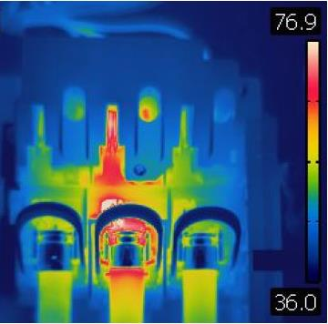
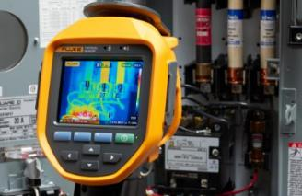
Electrical Infrared Testing
The common recommendation - It is recommended that Management secure a certified thermographic technician to conduct an infrared scan of the facility electrical equipment and systems per NFPA 70B Recommended Practice for Electrical Equipment Maintenance
Solution: Based on NFPA 70B (2026), it is recommended that IR scans on all electrical equipment be completed annually in accordance with Table 9.3.2. Additionally, per section 9.1.2, if no major defects or deficiencies are found over two consecutive years, the maintenance frequency may be extended to every 24 or 36 months.
Can be completed by:
Vendor
Internal Staff
Fires
Faulty Wiring
Overloaded Circuits
Defective Appliances
Improper Use of Extension Cords
Poor Maintenance
$$

Slide 13
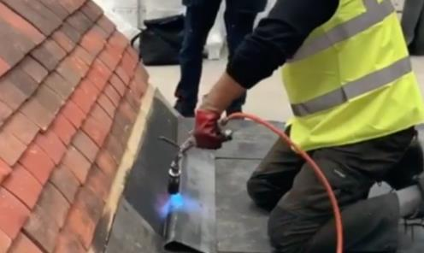
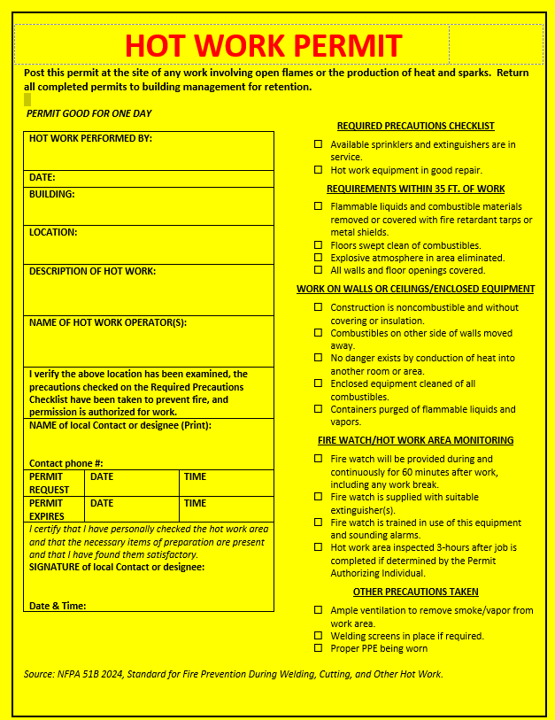
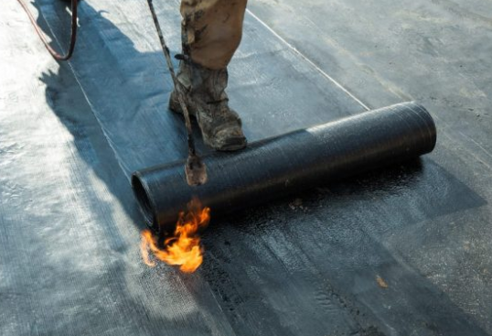
Hot Work Permit Program
The common recommendation - Establish and implement a formal “hot work” program that ensures that all individuals involved in any hot work operations, including contractors, are familiar with the procedures and requirements of safely performing hot work on the grounds. Hot work includes, but is not limited to, welding and allied processes, heat treating, grinding, thawing pipe, powder-driven fasteners, hot riveting, and similar applications producing a spark, flame, or heat. The program should follow the guidelines and procedures established in National Fire Protection Association NFPA 51B Standard for Fire Prevention During Welding, Cutting, and Other Hot Work (2024 Edition).
Solution:
Free download of a hot work permit is available from the NFPA at:
https://www.nfpa.org/downloadable-resources/forms/hot-work-permit?l=0
Can be completed by:
County Management
Vendors
Maintenance Staff
$

Slide 14
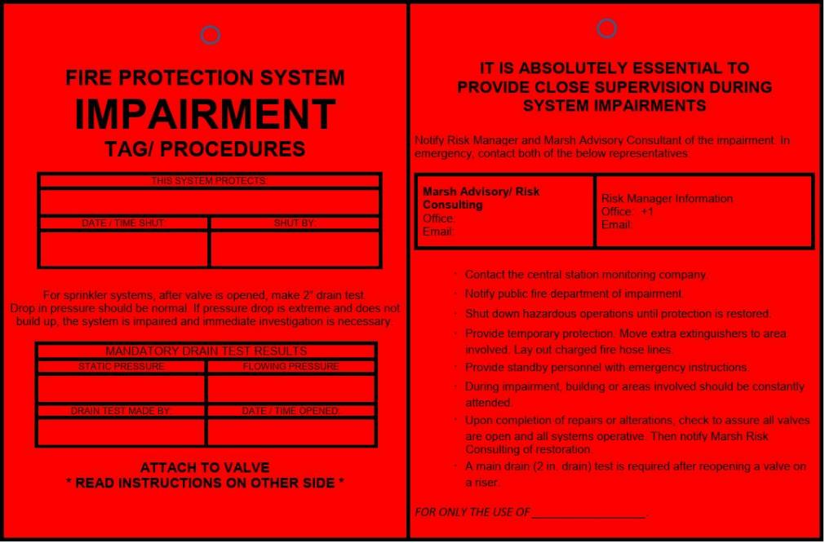
Fire Impairment Program
The common recommendation - Establish a formalized “impairment” program (for both pre-planned and emergency impairments) of the water-based fire protection system. The program should ensure that measures are taken during the impairment so that the increased risks are minimized, and the duration of the impairment is limited. The impairment program should follow the guidelines established in NFPA 25.
Solution: Contact the local fire department / county official / CRL and Marsh (Ken Botes)
There are three main types of impairments:
Planned – examples would be routine repairs to fire protection equipment, routine testing of fire protection systems and alarms
Hidden – shut fire protection valves that were not planned or known to the facility, there can be many causes for hidden impairments, which is why a robust fire protection system inspection program is also needed.
Emergency – examples would be power loss to the facility, water main breaks, ruptured sprinkler lines
Can be completed by:
County Management
Vendors
Maintenance Staff
$

Slide 15
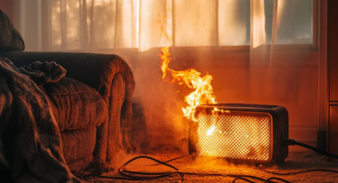
Electric Portable Space Heaters
The common recommendation - A space heater was observed in the lobby receptionist area within 1 ft. of combustibles and other space heaters were noted. Space heaters have a history of causing fires. Eliminating space heaters reduces the fire hazard.
Solution: Remove space heaters from the building and implement a policy that they are not to be used in the building.
HEATER CHECKLIST
Purchase a heater with the seal of a qualified testing laboratory - UL.
Keep the heater at least 3 feet away from any combustibles.
Choose a heater with a thermostat and overheat protection.
Place the heater on a solid, flat surface.
Make sure your heater has an auto shut-off to turn the heater off if it tips over.
Keep space heaters out of the way of foot traffic.
Plug the heater directly into the wall outlet.
Never use an extension cord.
Space heaters should be turned off and unplugged when leaving office or area.
Can be completed by:
County Management
Maintenance Staff
$

Slide 16
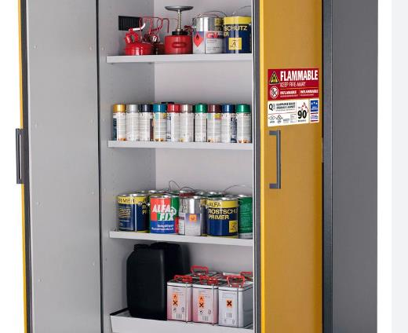
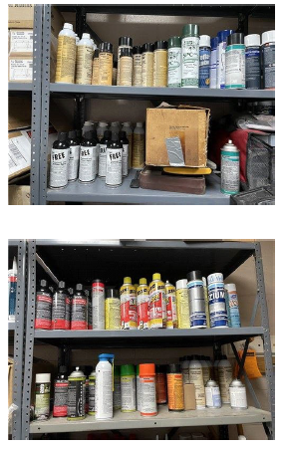
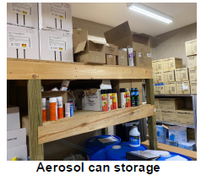
Fire Protection Inspection, Testing, and Maintenance
The common recommendation - Large number of the aerosol cans were stored uncontained on shelves. In the event of a fire involving these cans, the cans may rupture and rocket within the room, spreading fire as they go.
Solution:
Storage Guidelines - Limit Combustibles: Minimize the number of combustible materials stored in mechanical and electrical rooms. Ideally, these areas should be free of unnecessary items.
Proper Containers
Separation
Can be completed by:
County Management
Maintenance Staff
$$

Slide 17
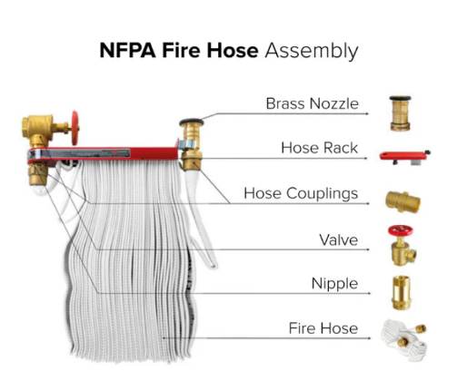
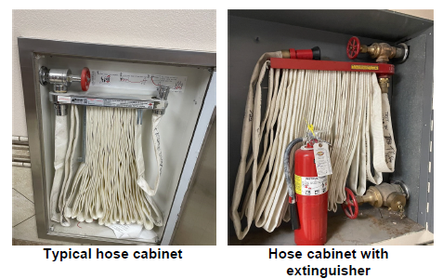
Fire Protection Inspection, Testing, and Maintenance
The common recommendation - It was noted the fire hose cabinets are provided with fire hoses which are not currently being inspected and not tested on an annual frequency. It was reported that facility occupants are also not trained in the use of fire hoses and are required to evacuate the building rather than attempt to fight a fire. Management should consider to service the hose station and hoses per NFPA 25.
Solution: Gain written permission from the local fire marshal or other authority having jurisdiction to remove the existing fire hoses from the cabinets while still maintaining the standpipe in ready condition for professional firefighters.
Can be completed by:
Internal maintenance
$

Slide 18
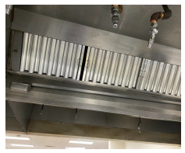
Kitchen Duct Cleaning / Grease Filters
The common recommendation - Increase the frequency of grease filter and duct cleaning in the cooking hood exhaust system.
Solution: Staff should be trained to replace the grease filters in the proper orientation after cleaning as well as verify that there are no gaps between the filters. Management should establish a system to inspect the plenum and exhaust duct areas at specific frequencies.
Can be completed by:
County Management
Vendors
Maintenance Staff
$$

Slide 19
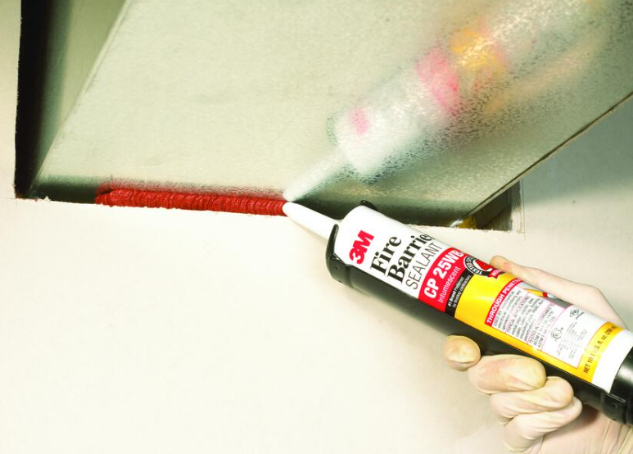
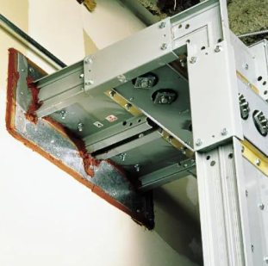
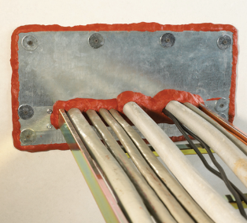
Seal Penetrations / Maintain fire barrier
The common recommendation - Contract a licensed company to protect the openings using an approved through-penetration firestop system installed and tested in accordance with ASTM E814 or UL 1479. The system should have an F rating not less than 1 hour but also not less than an equivalent level of fire resistance as the construction material surrounding the floor penetration.
Solution: Staff or vendors can seal penetrations in fire rated partitions, and the foam / barrier should have a minimum 1-hour, but not less than the required fire resistance rating of the floor.
Can be completed by:
Vendors
Maintenance Staff
$$

Slide 20
Documents to prepare
Protection Systems
Fire pump annual flow test report (most recent)
Automatic sprinkler system drawings
Sprinkler system annual test report
Gaseous suppression inspection report
Private fire hydrant flow test report
Fire extinguisher service frequencies
Security / Watchman services provided
Illegal entry alarms (type and monitoring company)
Building Construction & Drawings
Copy of site plan and other diagrams (rack storage layout & equipment layout)
Building(s) age, date of additions, building(s) area (dimensions or square footage)
Dedicated / Compartmentalized areas (computer rooms, clean rooms, building additions)
Construction features (Roof U/L fire & wind rating, exterior window wind rating, fireproofing rating)
Finished floor elevation (Elevation certificate, blueprints, etc.)

Slide 21
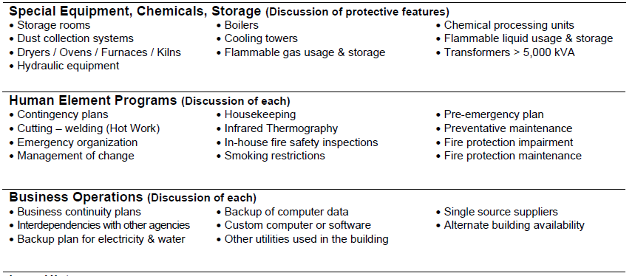

Slide 22
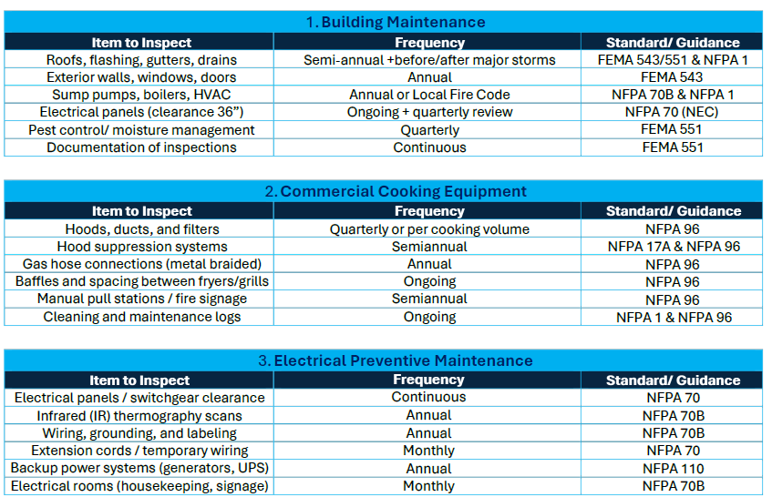
Maintenance Intervals – Code & Standard-Inspection Frequencies

Slide 23
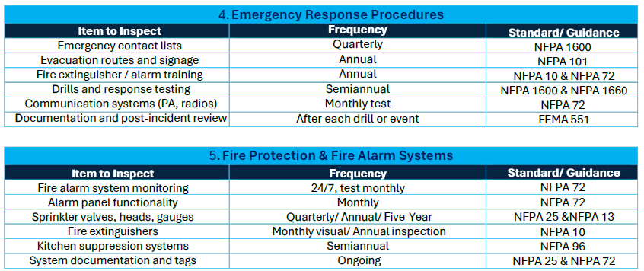
Maintenance Intervals – Code & Standard-Inspection Frequencies

Slide 24
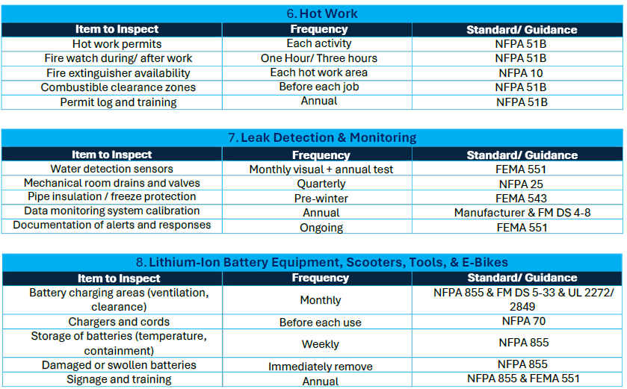
Maintenance Intervals – Code & Standard-Inspection Frequencies

Slide 25
Any questions or queries contact
      Ken E Botes
      Marsh Risk Advisory
      Ken.Botes@Marsh.com
      +1 404 216 3425

Slide 26
The information contained in this presentation is for educational purposes only and should not be construed as an endorsement of any kind for any vendor, service, or technology.
Do you own due diligence. You are encouraged to conduct your own research and due diligence before making any decisions based on the information presented.
No Legal Advice. The information presented is not a substitute for legal advice. Please consult with a qualified legal professional for advice specific to your situation.
Intended Purpose of Use. The information provided is furnished solely for the internal business purpose for which it was transmitted and may not be redistributed or used for any other purpose without prior written consent.

Slide 27
This document and any recommendations, analysis, or advice provided by Marsh (collectively, the “Marsh Analysis”) are not intended to be taken as advice regarding any individual situation and should not be relied upon as such. The information contained herein is based on sources we believe reliable, but we make no representation or warranty as to its accuracy. Marsh shall have no obligation to update the Marsh Analysis and shall have no liability to you or any other party arising out of this publication or any matter contained herein. Any statements concerning actuarial, tax, accounting, or legal matters are based solely on our experience as insurance brokers and risk consultants and are not to be relied upon as actuarial, tax, accounting, or legal advice, for which you should consult your own professional advisors. Any modeling, analytics, or projections are subject to inherent uncertainty, and the Marsh Analysis could be materially affected if any underlying assumptions, conditions, information, or factors are inaccurate or incomplete or should change. Marsh makes no representation or warranty concerning the application of policy wording or the financial condition or solvency of insurers or reinsurers. Marsh makes no assurances regarding the availability, cost, or terms of insurance coverage. Although Marsh may provide advice and recommendations, all decisions regarding the amount, type or terms of coverage are the ultimate responsibility of the insurance purchaser, who must decide on the specific coverage that is appropriate to its particular circumstances and financial position.

